Slide 1
STUDENT DETAILS
Name:- Anantha Teja Dasari
Skillsbuild Email:-ananthateja_dasari@srmap.edu.in
College:- SRM AP , Amaravati
Internship Domain:- Data Analytics (DA)
Start Date:- 12/06/2023
End Date:- 24/07/2023
Internship ID:- INTERNSHIP_168198413964410a8b547b1
AICTE Student ID:- Student ID: STU646262dbbf4981684169435

Slide 2

PROJECT TITLE/Problem Statement
Analysis of Sample Superstore Dataset
Analyze a case study of a sample super store using data analysis techniques. By examining the data, we aim to gain insights into the store's performance, customer behavior, and inventory management, ultimately optimizing its operations and profitability.
The objective of this presentation is to showcase how data analysis can provide valuable insights and drive decision-making in the retail industry. By presenting the findings of this case study, we aim to highlight the importance of leveraging data to improve store performance and enhance the customer experience.
We will explore how data analysis techniques can uncover hidden patterns, identify opportunities, and provide actionable insights to drive strategic decision-making in the retail sector.

Slide 3
Agenda
1. Introduction to the Sample Superstore Dataset:
Overview of the dataset structure and variables.
Understanding the business context and objectives of the project.
2. Data Exploration and Cleaning:
Exploring the dataset to identify missing values, outliers, and inconsistencies.
Cleaning the dataset by addressing missing values, outliers, and inconsistencies
3. Descriptive Analytics:
Performing basic statistical analysis to summarize and describe the dataset.
Generating descriptive statistics, such as mean, median, mode, standard deviation, etc., for relevant variables.
Visualizing data using charts, graphs, and histograms to gain initial insights.
4. Sales Analysis:
Analyzing sales trends to identify patterns and seasonality.
Examining the performance of different product categories and sub-categories.
Investigating the correlation between sales and other factors (e.g., region, customer segment, etc.).

Slide 4
5.Profitable Analysis:
Calculating profit margins for different products and product categories.
Identifying the most profitable and least profitable products.
6. Recommendations and Insights:
Summarizing the key findings and insights from the analysis.
Providing actionable recommendations to improve sales, profitability, and customer satisfaction.
Presenting the results in a clear and concise manner using visualizations and data-driven insights.
7. Conclusion:
Concluding the analysis project has delivered valuable insights and actionable recommendations to drive the super store's performance.
Reflecting on the limitations of the analysis and potential areas for further exploration. in advanced techniques and external factors can contribute to continued improvement and success in the dynamic retail industry.

Slide 5

Project Overview
The analysis of the Sample Super Store Data set is useful in many ways to many users . For investing stock purposes and many more.
Some of the questions that can be answered after this analysis are:
Top 10 States have most profit
Distribution based in different State
Loss in different Segments
The most preferred ship mode
Distribution based on Category and Subcategory
The most profitable sub-category

Slide 6

END USERS
1. Store employees: The database can be accessed by store employees for various tasks such as managing inventory, processing sales transactions, updating customer information, and generating reports.
2. Store managers: Managers can utilize the database to monitor sales and inventory levels, analyze customer trends, make informed decisions regarding stock replenishment, and track overall store performance.
3. Customer service representatives
4. Marketing and sales teams
Marketing and sales teams can leverage the database to analyze customer behavior, identify target demographics, develop marketing strategies, and track the effectiveness of promotional campaigns.
5. Finance department: The finance department can utilize the database for financial analysis, budgeting, and tracking expenses. They can also generate financial reports and monitor revenue and profit margins.

Slide 7
SOLUTION AND ITS VALUE PROPOSITION
Solution:
Our solution for the Analysis of Sample Superstore Dataset project revolves around leveraging advanced data analytics techniques to extract valuable insights from the provided dataset. Through a comprehensive process of data exploration, cleaning, and analysis, we aim to uncover hidden patterns, trends, and relationships within the data. The project encompasses various key components, including customer segmentation, sales analysis, profitability analysis, and customer behavior analysis, among others.
1. Sales Analysis: We will conduct an in-depth analysis of sales data, examining trends, seasonality, and correlations with various factors such as promotions, pricing, and product categories. This analysis will provide insights into the store's top-selling products, peak sales periods, and opportunities for revenue growth.
2. Profitability Analysis: We evaluated the profit of different products, product categories, and customer segments. This analysis will help the store identify high-profit areas, optimize pricing strategies, and allocate resources effectively to maximize profit.
3. Customer Behavior Analysis: By analyzing customer purchase history, browsing patterns, and interactions with the store, we will gain insights into customer preferences, buying habits, and loyalty. This analysis will enable the store to develop targeted marketing campaigns, improve customer retention, and enhance the overall customer experience.
Through our comprehensive data analytics approach, the Analysis of Sample Superstore Dataset project aims to empower the store with actionable insights that can drive strategic decision-making, optimize operations, and ultimately improve the store's performance and profitability.

Slide 8
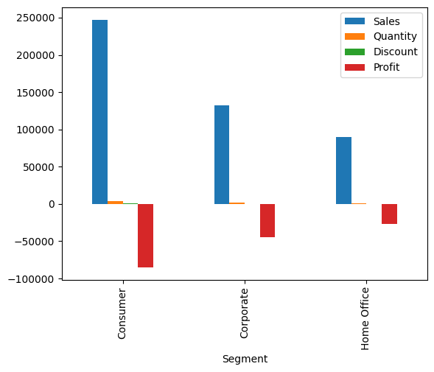
Loss in different Segments
Clearly visible that the sales in consumer segment is high and the loss is also high.
So there needs to make changes to reduce it or change it.

Slide 9
Value Propostion:
Actionable Insights: Our analysis provides actionable insights to the management team of Sample Superstore, enabling them to make data-driven decisions. The findings help identify areas of improvement, optimize operations, and enhance profitability.
Enhanced Decision Making: Our project enables enhanced decision-making by promoting data-driven approaches, providing a deeper understanding of the dataset, mitigating risks, optimizing resource allocation, fostering proactive strategies, facilitating evaluation and monitoring, instilling confidence in decision-making, and aligning decisions with organizational goals.
Improved sales and adaptability: Our project contributes to improved sales and customer satisfaction by enhancing sales strategies, personalizing the customer experience, optimizing pricing, improving product assortment, implementing targeted marketing campaigns, fostering customer retention and loyalty, enhancing customer service, and gaining a competitive advantage in the market.

Slide 10
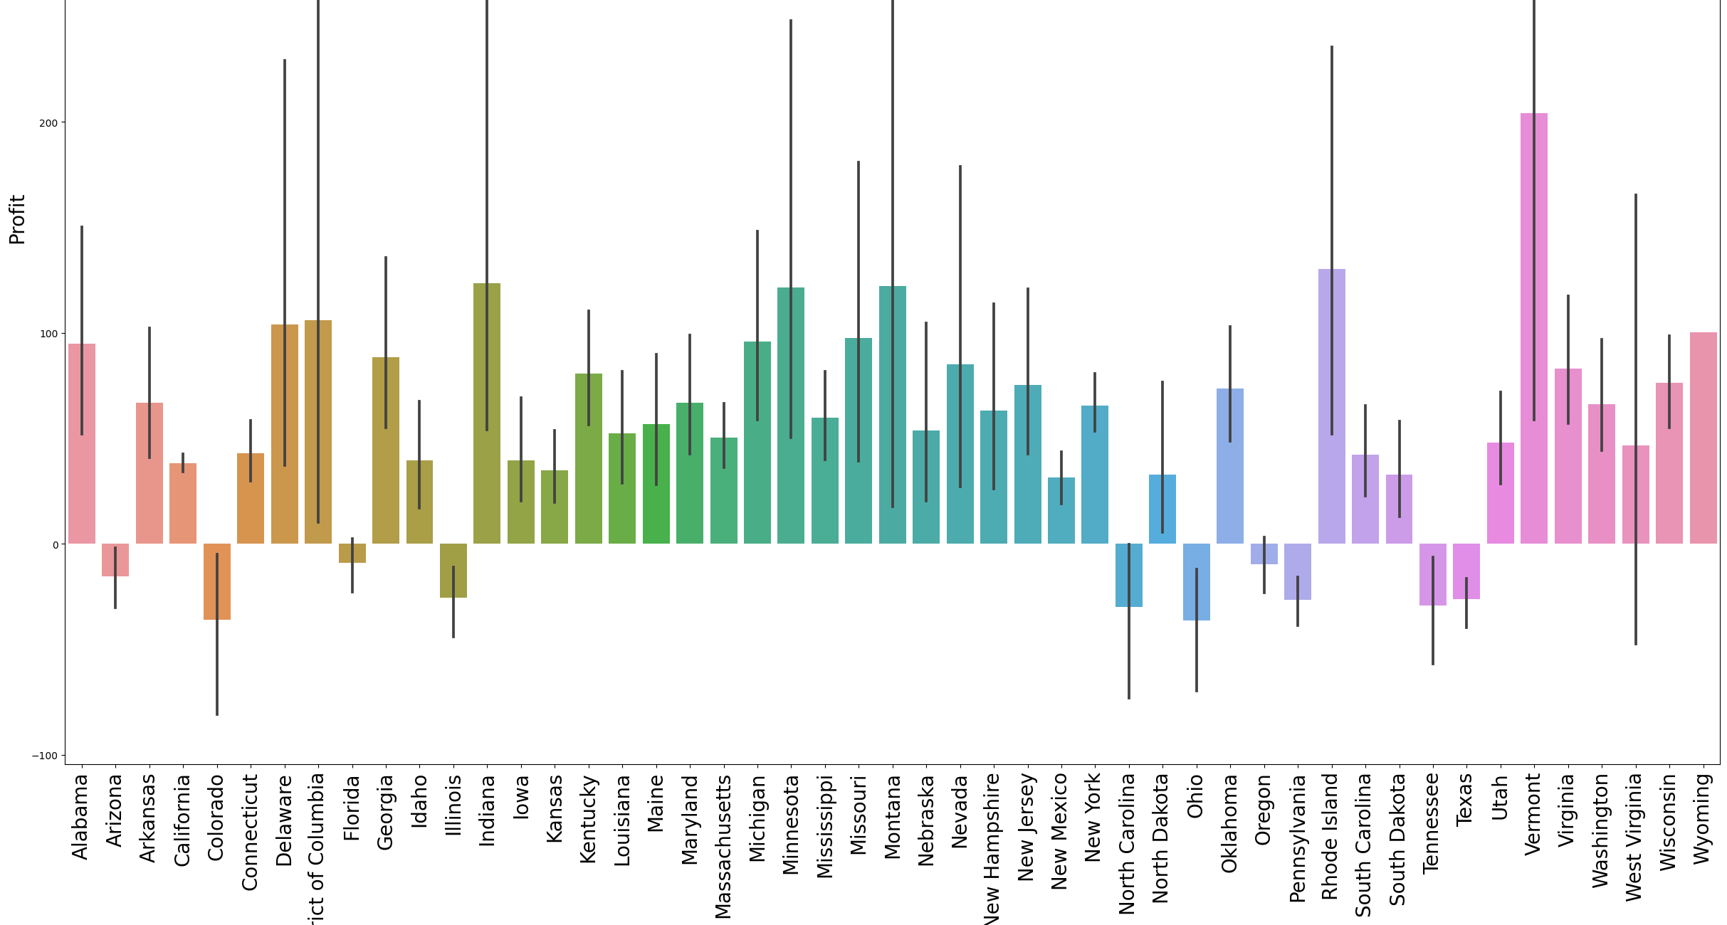
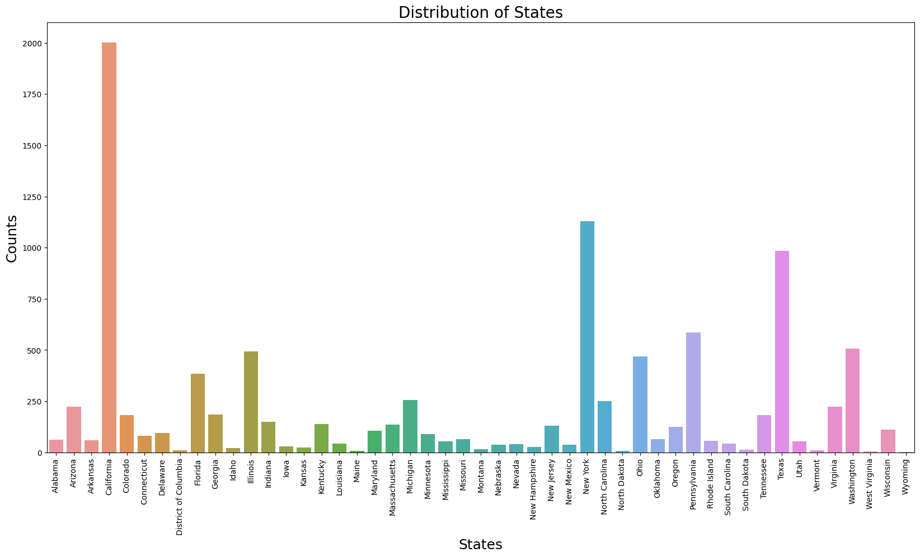
Most Profit State: Vermont
Most Loss State: Ohio
California has the most distributions followed by
NewYork.
Even though California has more distributions the profit is very low compared to the distributions and profit of Vermont
Profit and looses over different States
Profit and looses over different States
Distribution in different States
The analysis tells us that :
There is a need or requirement to look into the States that have loss and the States that have high Distribution and low Profit.
Distribution should be increased in various Different states according to the profits they are gaining.

Slide 11
HOW DID YOU CUSTOMIZE THE PROJECT AND MAKE IT YOUR OWN
Understanding the Project Objectives: I thoroughly reviewed the project objectives, ensuring I had a clear understanding of what needed to be achieved through the data analysis. This allowed me to tailor my approach and analysis techniques to meet the specific goals of the project.
Data Exploration and Preparation: I carefully examined the provided sample super store database, understanding its structure, variables, and any data quality issues. This involved data cleaning, handling missing values, addressing outliers, and ensuring the dataset was suitable for analysis.
Data Analysis and Interpretation: I performed in-depth data analysis using statistical methods, visualization tools, and domain knowledge. This involved identifying sales trends, uncovering patterns in customer behaviour, assessing profitability across different product categories, sub-category and drawing meaningful insights from the data.
Visualization and Reporting: I created visually appealing charts, graphs, and dashboards to effectively communicate the analysis findings and insights. Customized visualizations helped stakeholders easily grasp the key takeaways from the data analysis and supported data-driven decision-making.

Slide 12
Modelling
Descriptive Analysis: Descriptive analysis techniques were employed to understand the current state of the super store's performance. This included visualizations such as line charts, bar graphs, and heat maps to analyze sales trends over time, customer distribution across geographical regions, and summary statistics of sales, customer demographics, and inventory levels. These visualizations provided a foundation for identifying patterns and understanding the overall performance of the store.
Customer Segmentation: Customer segmentation was performed to categorize customers based on their characteristics and behavior. This involved employing clustering algorithms and demographic variables to group customers into distinct segments.
Profitability Analysis: Profitability analysis involved assessing the profitability of different product categories, customer segments, or individual products.

Slide 13
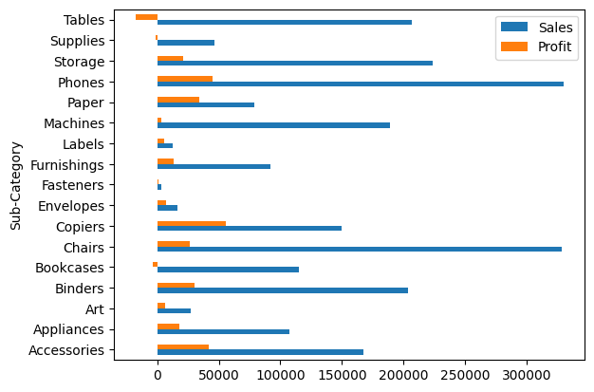
The most Profitable Sub-category
This graph shows the sales and profit vs Sub-Category .
Copiers being the most profitable its Sales are not high , so there is a need to increase to the number of sales
Tables giving losses while sales are high. So necessary action can be taken there like stopping the sale of these.

Slide 14
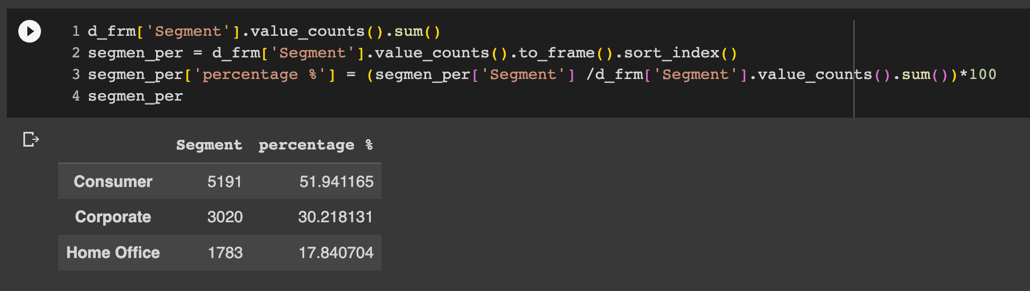
Results
The supermarket spent more money on furniture sales, but as a result, there were significant losses.I think that is the cause of our supermarket loss
Ohio has the worst profit-to-sales ratio in terms of total sales and the losses beared.
Delaware has the highest profit-to-sales ratio.
The states making the largest profits for the company, namely New York, California and Washington DC don't have the highest profit-to-sales ratio. This means that the company can further improve its sales/profits in these states.
Technology part have sold a few number products with high profit we we can enhance earnings by give discount on some products to sell more and more.
For buying the products, there are 3 Clients.. (Consumer - Corporate - Home Office )
the most loyal customer is Consumer by 51% and Corporate by 30%

Slide 15
Links
Google –Collab:-
https://colab.research.google.com/drive/1bcyCfG0-59hgMtNd0w6e54KC6xisalmR?usp=sharing
GitHub Repo:-

Slide 16
Thank You

